Slide 1
Apache Commons Codec SW Dependability
Leonardo Falanga – 0522502019
https://github.com/apache/commons-codec

Slide 2
INTRODUCTION

Slide 3
INTRODUCTION
The software dependability analysis project conducted through the Apache Commons CodecTM, an open-source collection of components that provides algorithms for encoding and decoding data.
In particular it is created in order to consolidate Base64 encoder development efforts across projects.
BUT why all this effort for a BASE64/32 etc. encoding?

Slide 4
Introduction
01
Reusability
02
Ease of Use
Developers can avoid “reinventing the wheel”.
A single library simplifies encoding and decoding by offering an easy-to-use API.
Standardization
Security
03
04
It ensures that encoding and decoding processes conform to widely accepted standards
Encoding and hashing algorithms like MD5, SHA, and Base64 can have subtle vulnerabilities when implemented incorrectly.
Efficiency
Modularity
05
06
Apache Codec is optimized for performance, ensuring that tasks like hashing or encoding are executed efficiently
Apache Codec isolates encoding-related functions in a standalone library, avoiding dependencies on larger frameworks, and making it lightweight.

Slide 5

— Apache Commons Codec ™

Slide 6
SW Quality Analysis Test

Slide 7

SonarCloud
The project’s quality and security were evaluated through SonarCloud, a platform that scans the code and performs static analysis to identify bugs, code smells, and potential vulnerabilities.
The analysis yielded the following outcomes:
• 2 bug
• Over 1400 code smells
• 0 vulnerabilities
• 31 security hotspots
• 1.5% code duplication

Slide 8
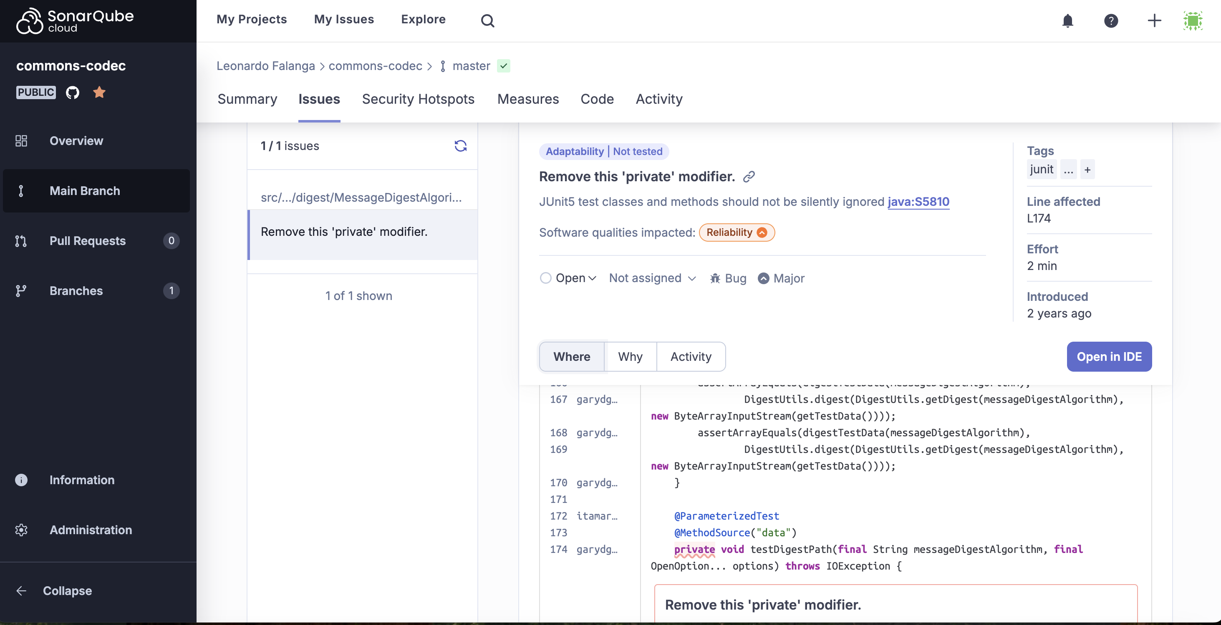
SonarCloud
”Remove this ’private’ modifier”: JUnit5 test classes and methods should not be silently ignored.
The message indicates that in the JUnit 5 test
class, I have one or more classes or methods de-
fined with the private access modifier.
This is a problem because JUnit 5 automatically
ignores these entities, making the tests unusable
without any warning, which can compromise soft-
ware reliability.
But changing this option causes problems.
So I considered this bug a false positive if the method or class is designed to be used only
internally and contains references or logic closely
related to the context in which it is defined,

Slide 9
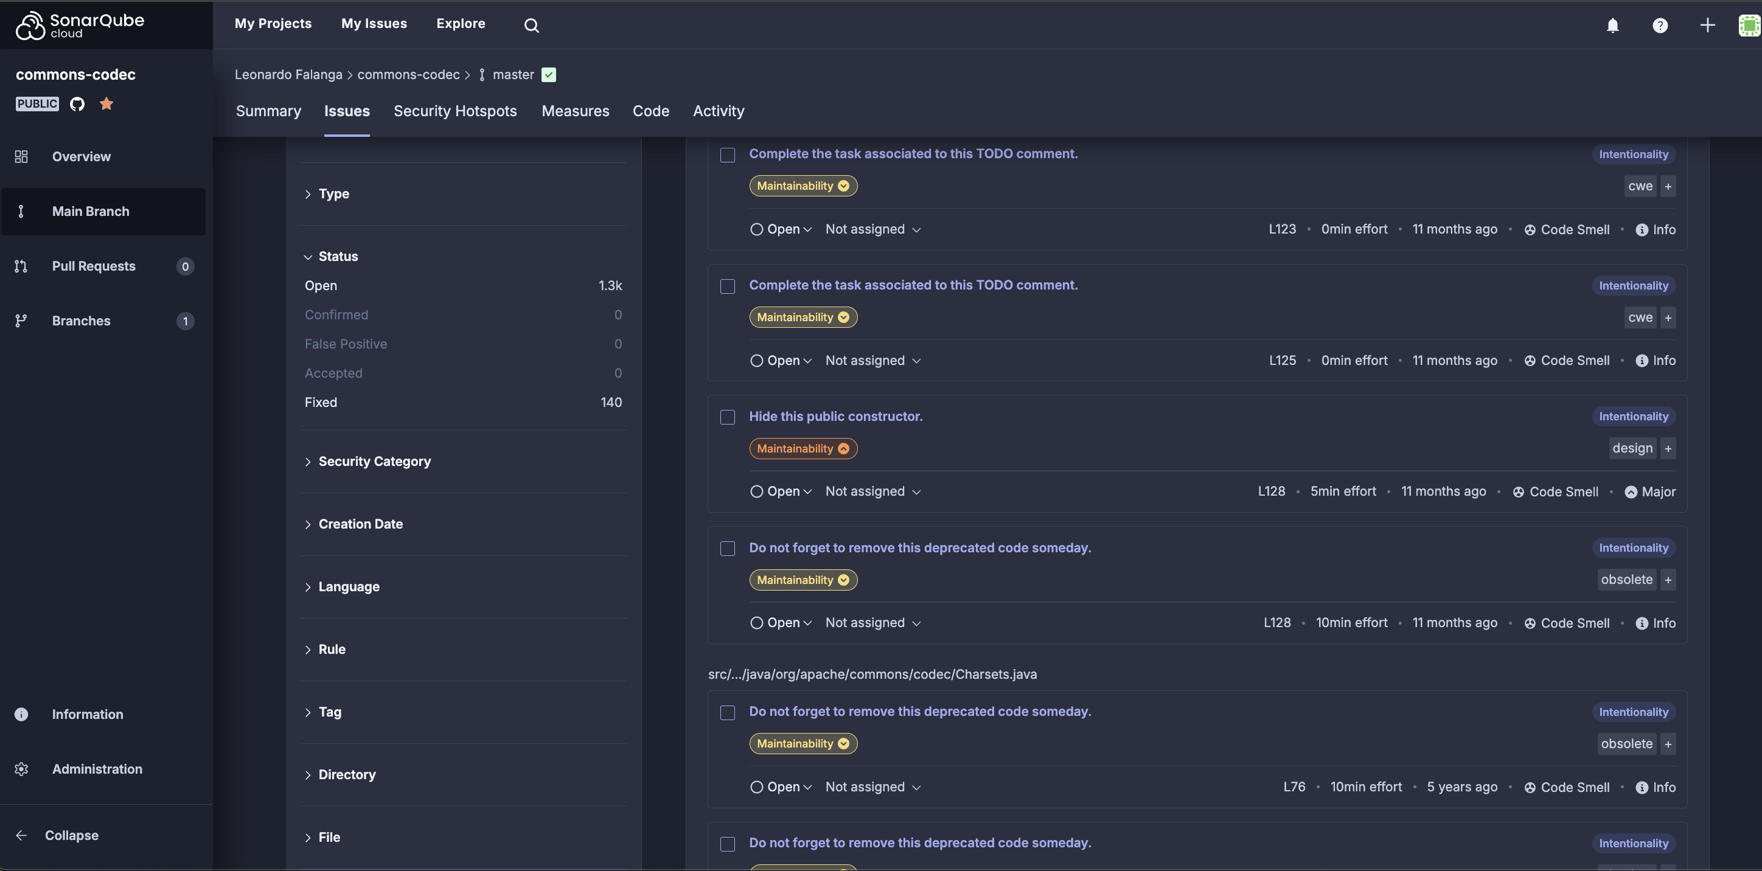
SonarCloud
Solved:
• 1 critical bug
• Over 140 code smells

Slide 10
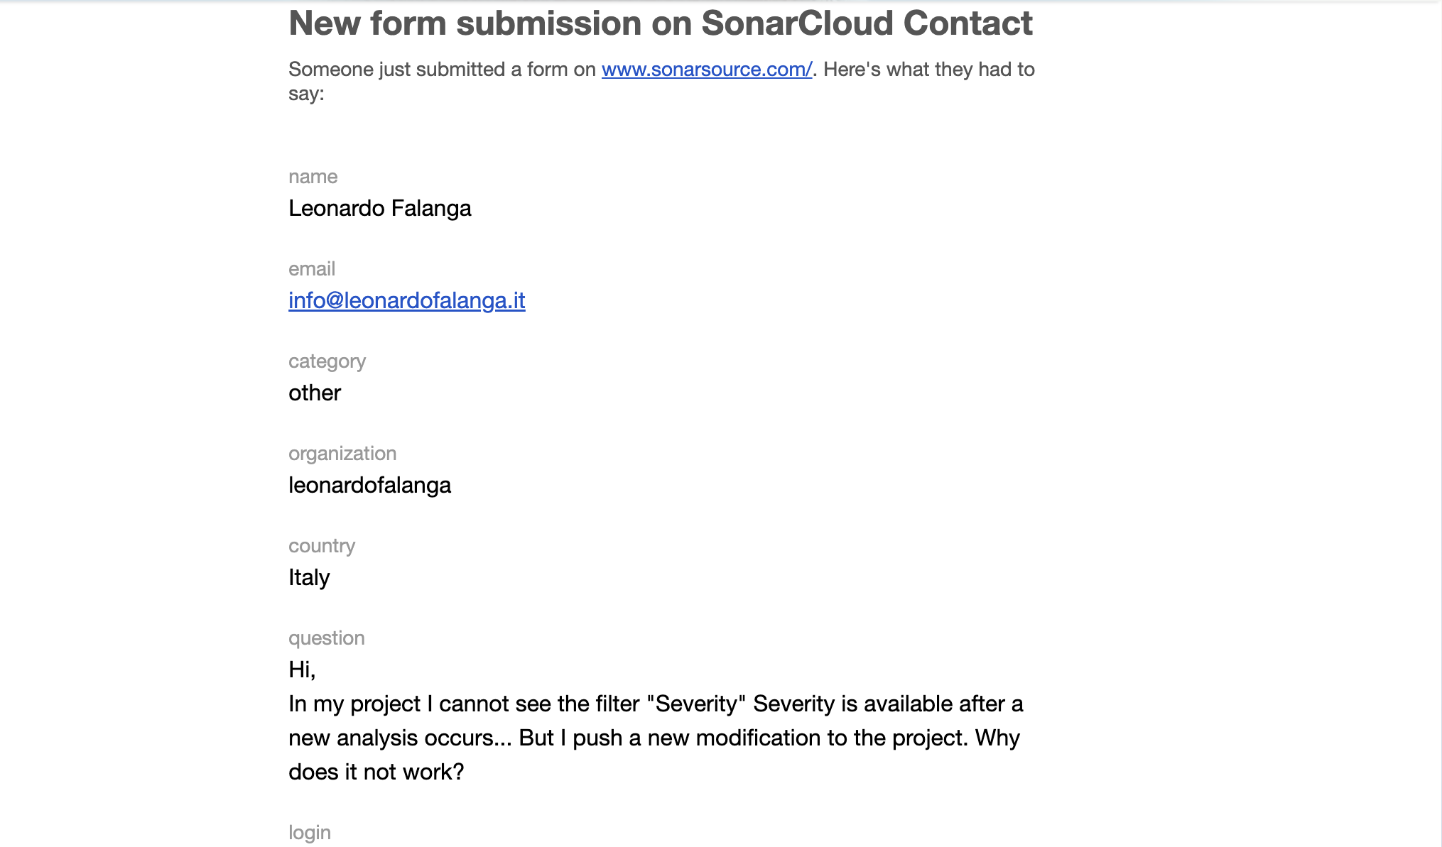
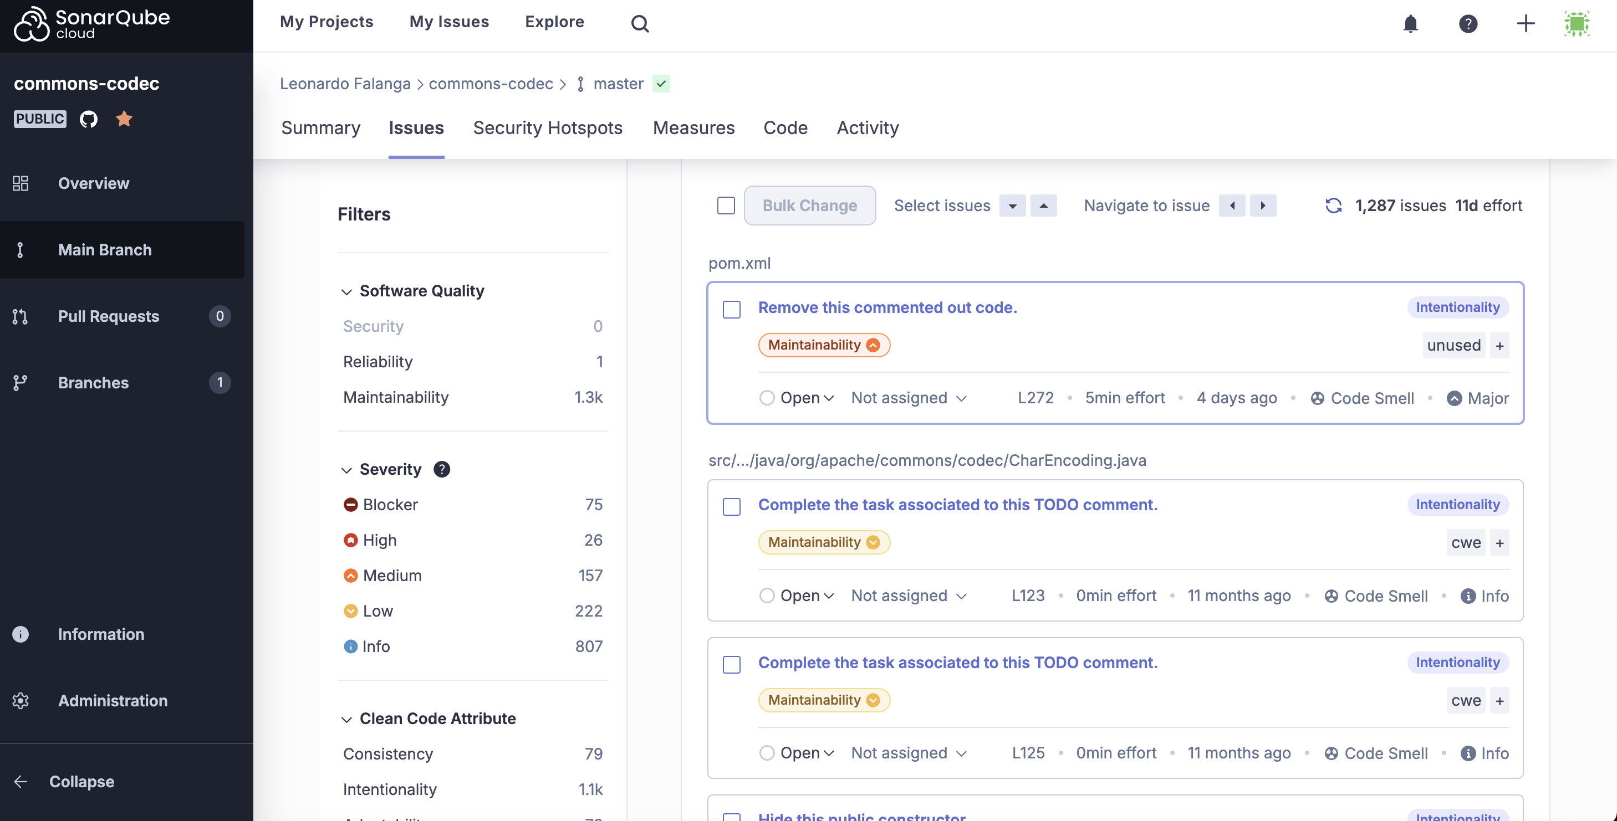
SonarCloud
During the Christmas vacations, I encountered a bug with SonarCloud’s “Severity” filter.
I proceeded to check with my colleagues who experienced the same error and wrote to technical support.

Slide 11

DOCKER

Slide 12
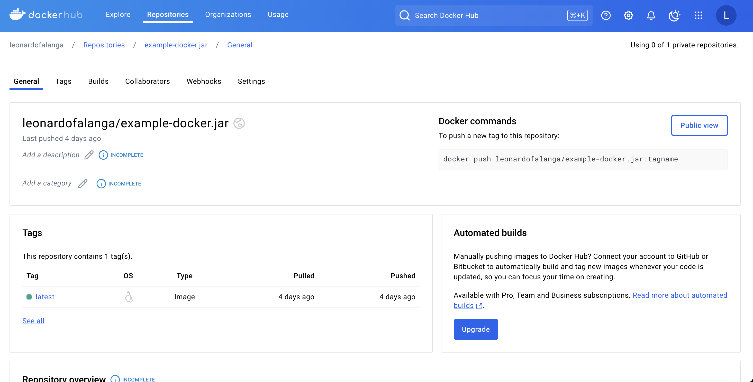
DOCKER

Slide 13
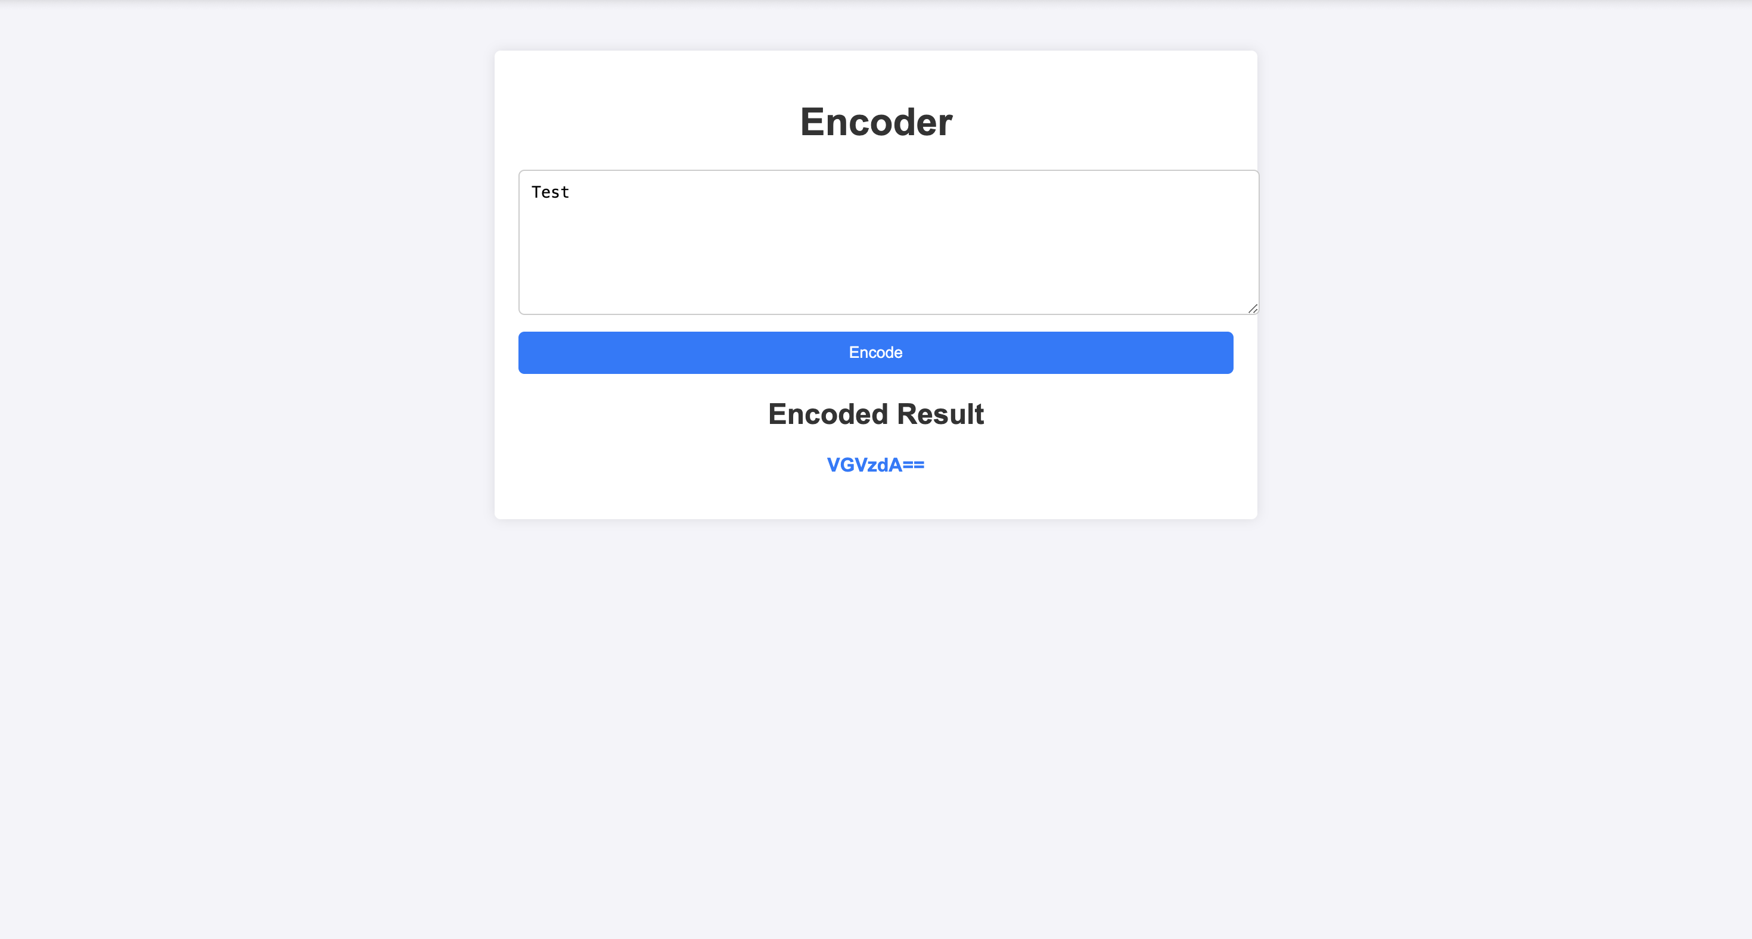
Example Test

Slide 14
CODE COVERAGE ANALYSIS

Slide 15

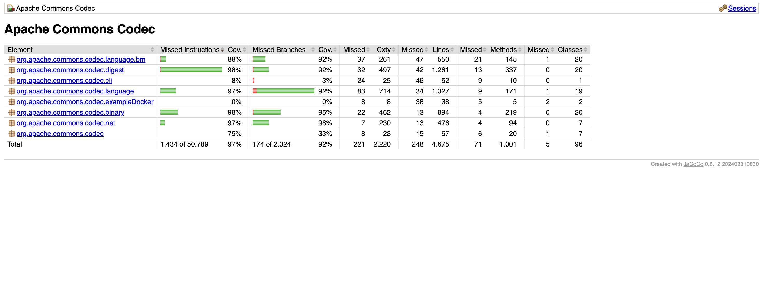
JACOCO

Slide 16
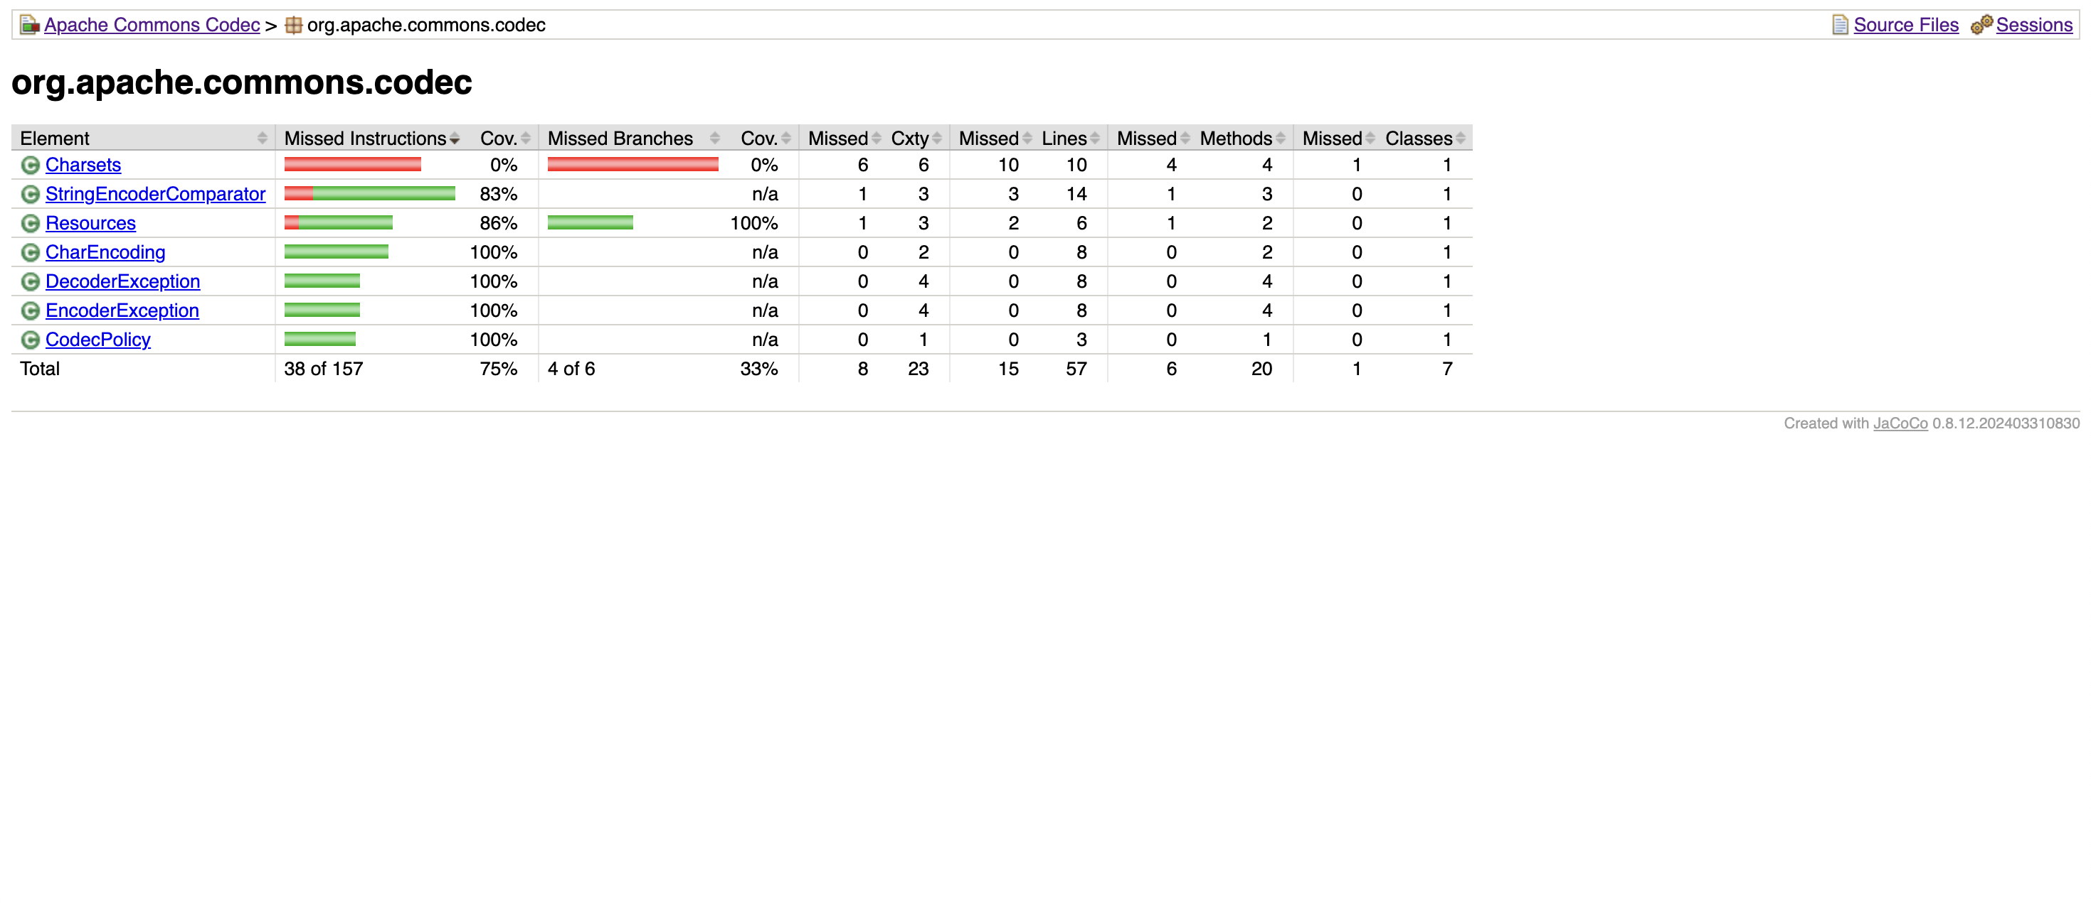
JACOCO

Slide 17


GITHUB COPILOT VS

Slide 18
MUTATION TESTING

Slide 19

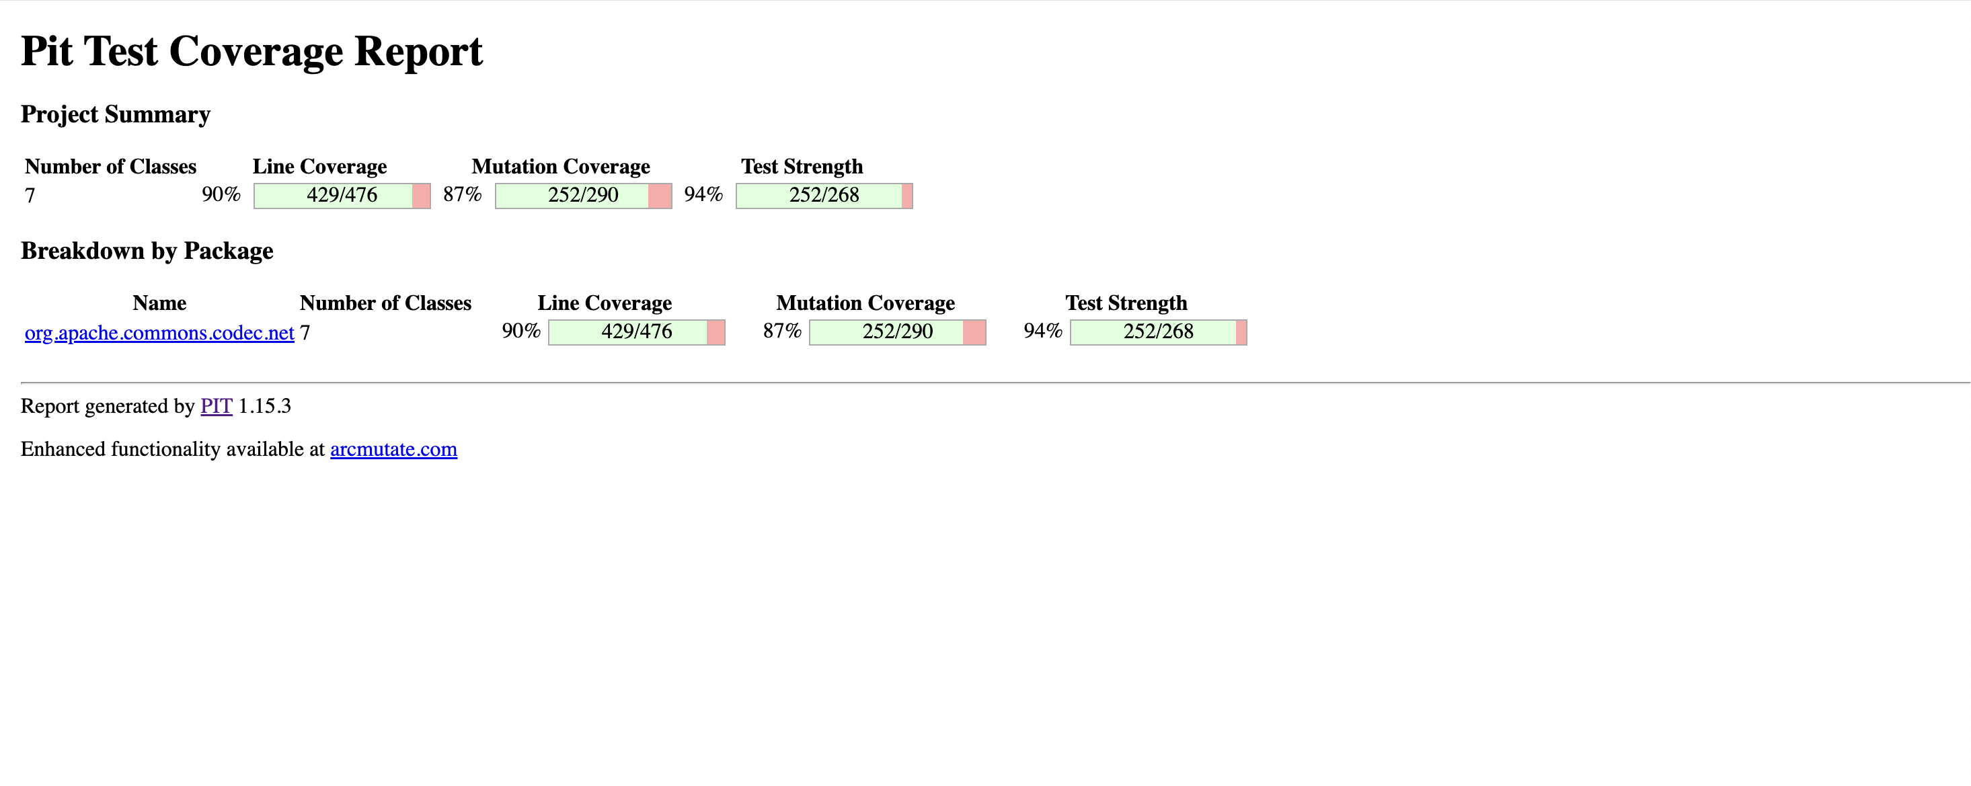
PITest

Slide 20
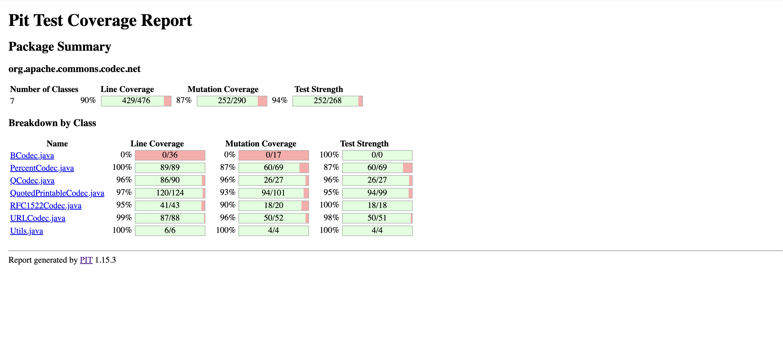
PITest

Slide 21
Automatic Test Case Generation

Slide 22

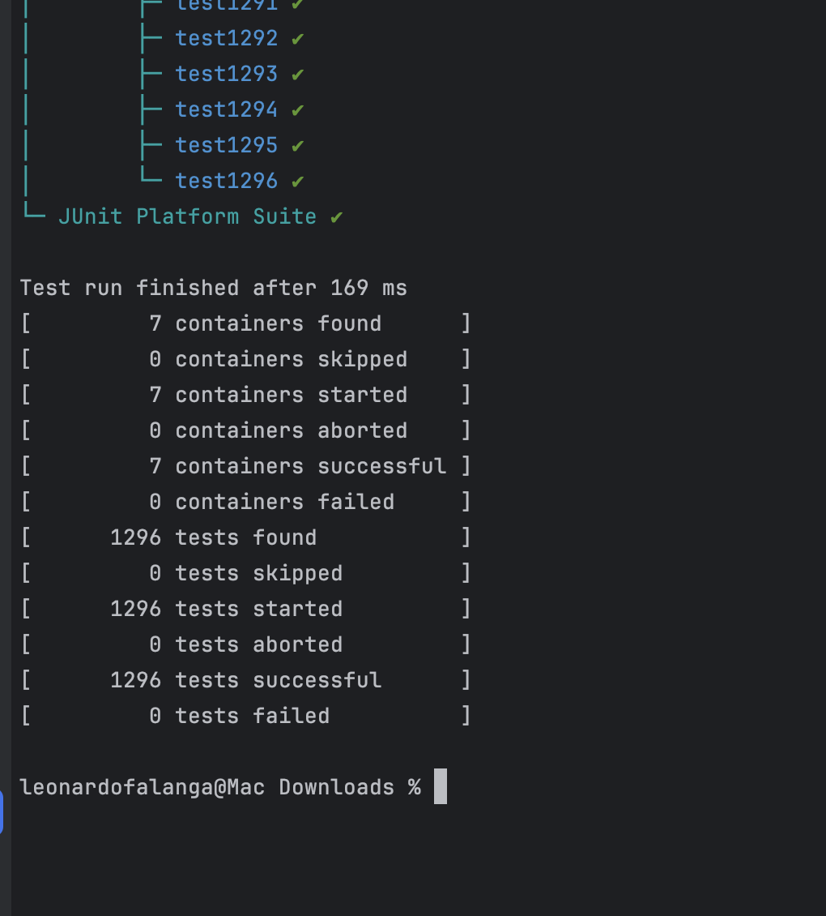
RANDO0P
java -cp randoop-tests:./commons-codec/target/classes:randoop-all-4.3.2.jar:./commons-codec/target/dependency/junit-platform-console-standalone-1.9.2.jar org.junit.platform.console.ConsoleLauncher -scan-class-path

Slide 23
Performance Testing

Slide 24
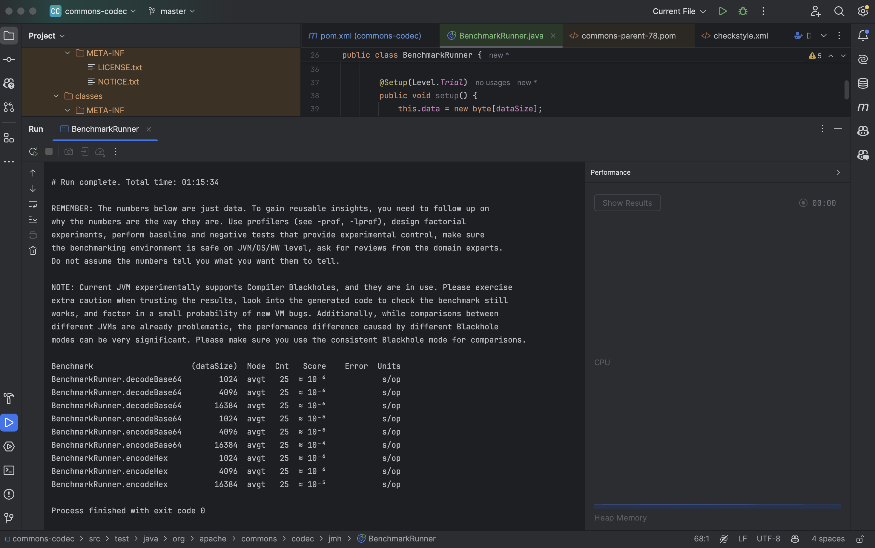
Java Microbenchmark Harness (JMH)

Slide 25
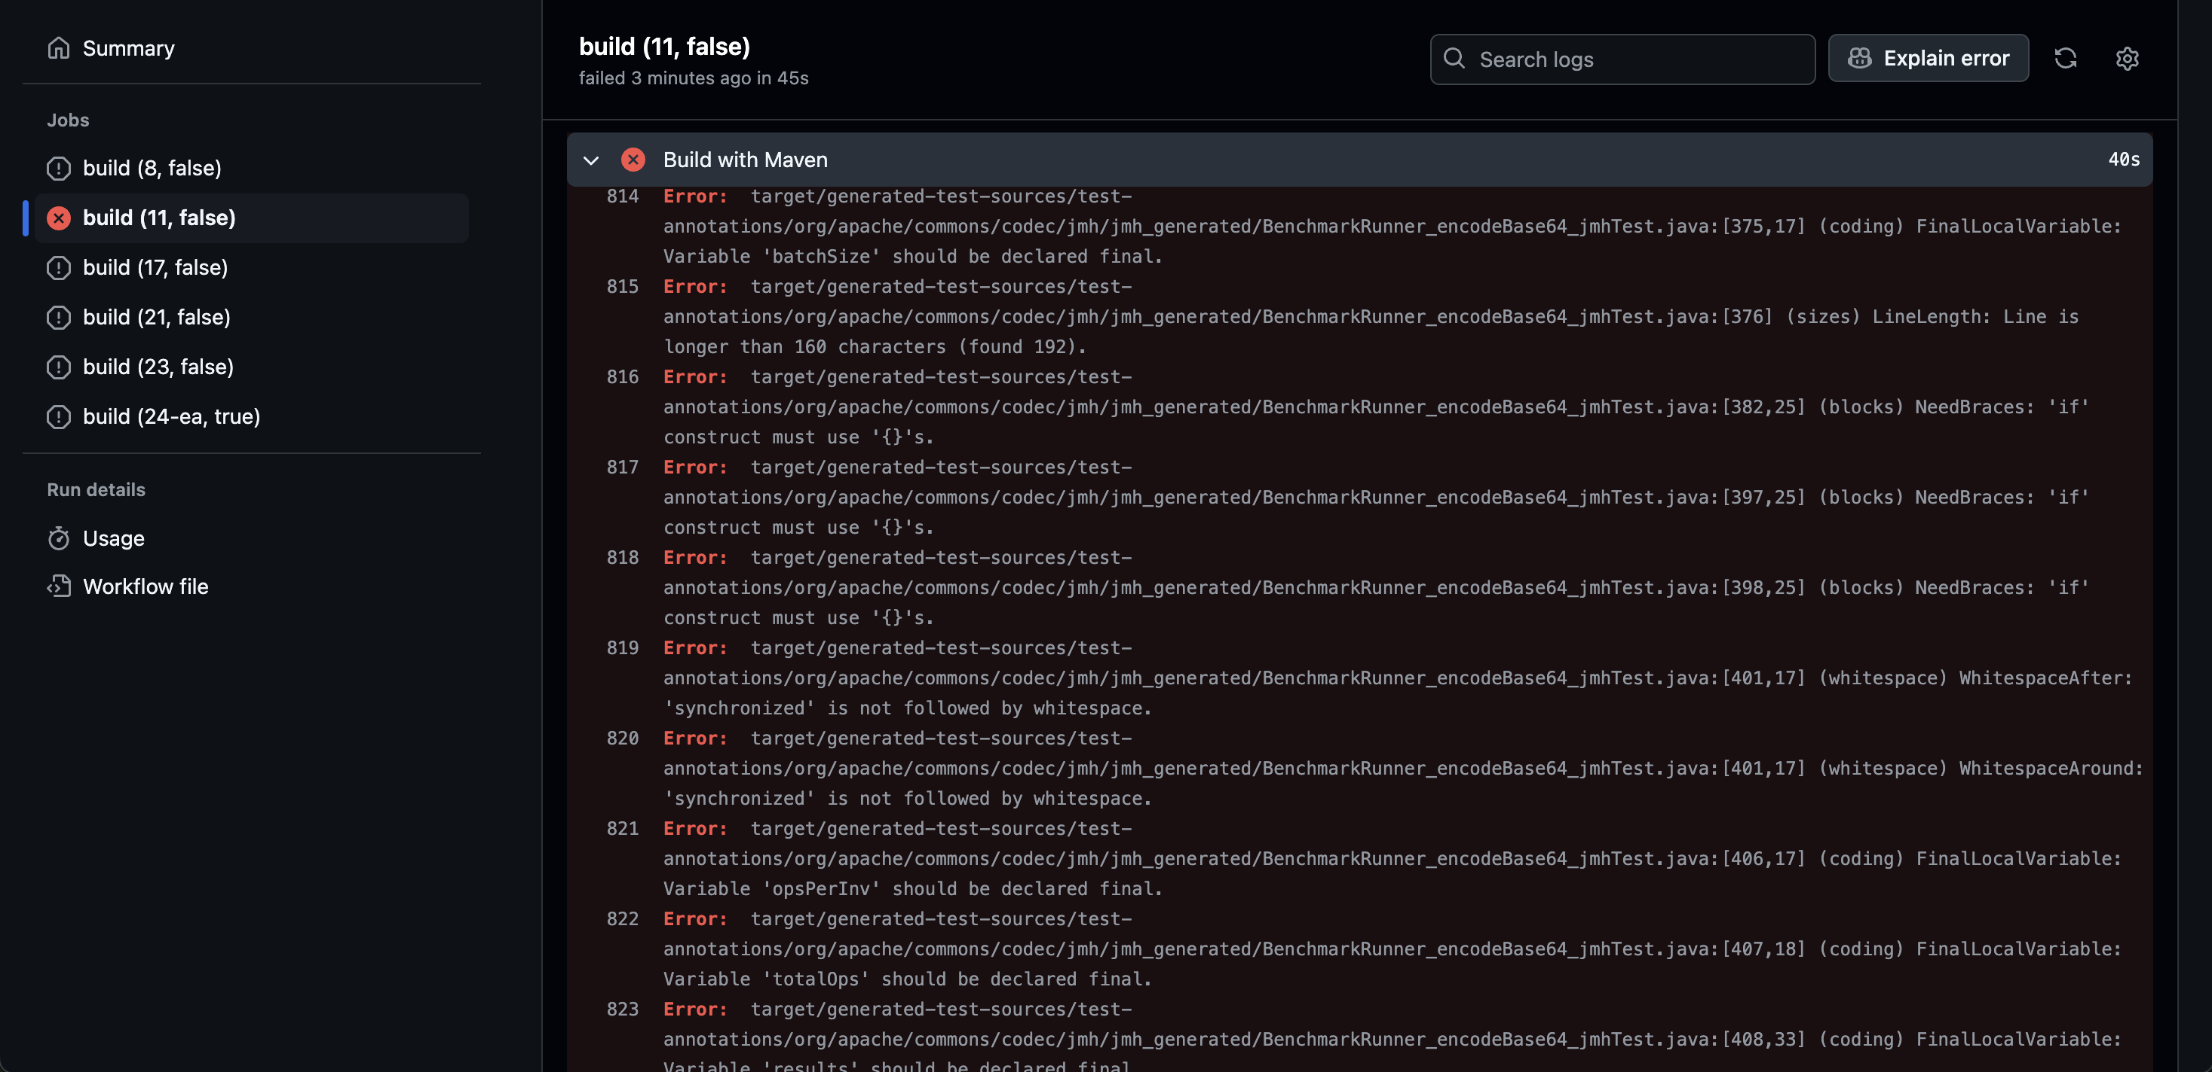

Christmas present

Slide 26
Software Vulnerabilities

Slide 27
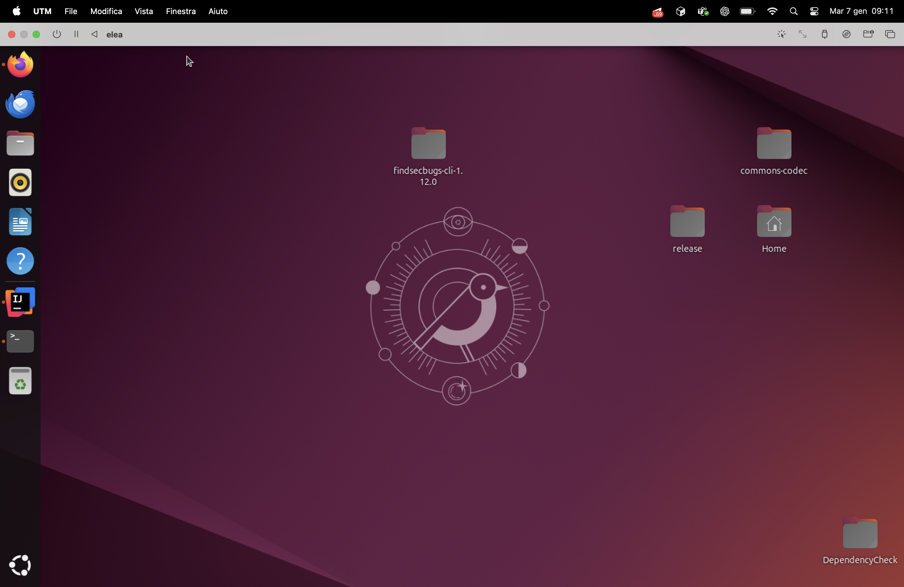
Ubuntu

Slide 28

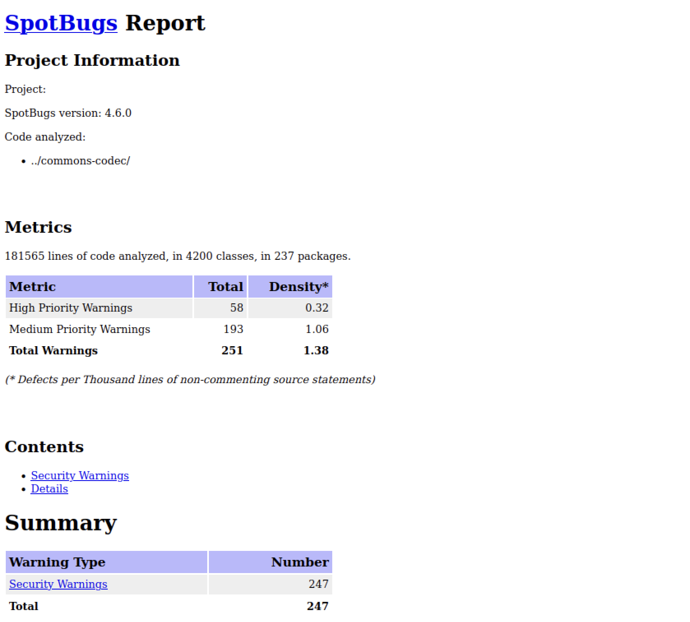
Find Security Bugs

Slide 29

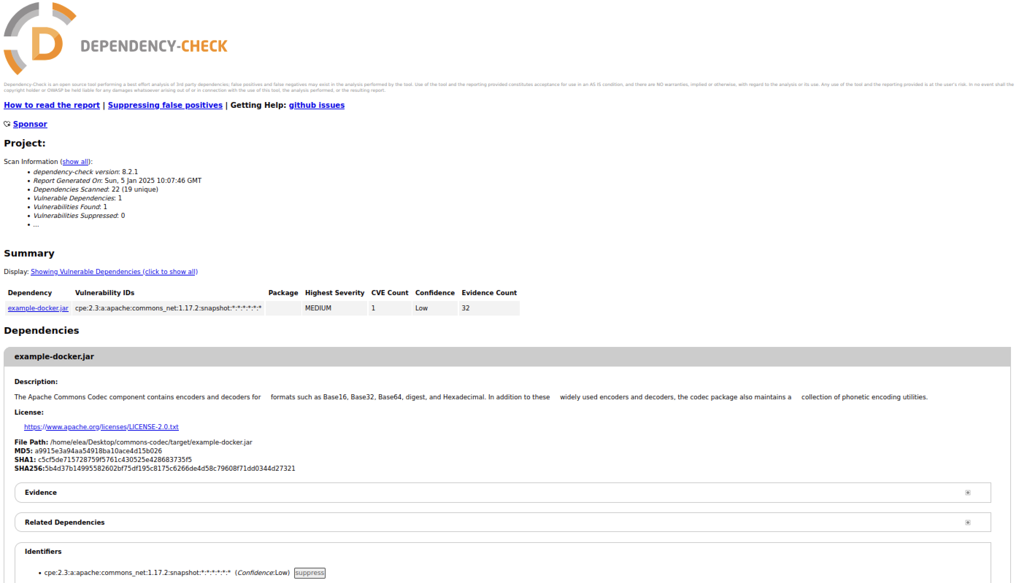
OWASP DC

Slide 30
THANKS!
Do you have any questions?
https://github.com/leonardofalanga/commons-codec.git

